Slide 1

Microservices and APIs
21st May 2019

Slide 2
Agenda
Definitions
Monolithic architecture
Microservices architecture
Practical considerations

Slide 3
Agenda
Definitions
Monolithic architecture
Microservices architecture
Practical considerations

Slide 4
Cloud Native
An application architecture designed to leverage the strengths and accommodate the challenges of a standardized cloud environment, including concepts such as elastic scaling, immutable deployment, disposable instances, and less predictable infrastructure.
“…a new computing paradigm that is optimized for modern distributed systems environments capable of scaling to tens of thousands of self healing multi-tenant nodes.
Cloud native systems will have the following properties:
(a) Container packaged. Running applications and processes in software containers as an isolated unit of application deployment, and as a mechanism to achieve high levels of resource isolation. Improves overall developer experience, fosters code and component reuse and simplify operations for cloud native applications.
(b) Dynamically managed. Actively scheduled and actively managed by a central orchestrating process. Radically improve machine efficiency and resource utilization while reducing the cost associated with maintenance and operations.
(c) Micro-services oriented. Loosely coupled with dependencies explicitly described (e.g. through service endpoints). Significantly increase the overall agility and maintainability of applications ”
https://www.cncf.io/about/charter/

Slide 5
Definitions of Microservices
Definition from experts
Composing a single application using a suite of small services
(rather than a single, monolithic application)
Each running as independent processes
(not merely modules / components within a single executable)
Intercommunicating via open protocols
(like HTTP/REST, or messaging)
Separately written, deployed, scaled, and maintained
(potentially in different languages)
Services encapsulate business capability
(rather than language constructs (classes, packages) as primary way to encapsulate
Services are independently replaceable and upgradable
“Developing a single application as a suite of small services, each running in its own process and communicating with lightweight mechanisms, often an HTTP resource API.” – Martin Fowler
“Fine-grained SOA”
– Adrian Cockcroft

Slide 6

What is an Application Programming Interface (API)?
An API is a specification of a service that describes the service’s functionality and how it must be used.
APIs act as a window into a service, allowing other services to interact with the service without the need to expose its entire code.
Application Programming Interface
APIs are pieces of software code that provide a set of technical specifications to efficiently interact with and ultimately integrate applications and business systems.
An API is strategic and it ought to move to the strategic conversation because APIs have consequences to the entire franchise – it is more than just an impact on the IT group.
Notes:
APIs have traditionally been a topic relegated to programmers and architects, as they provide a set of technical specifications to efficiently interact with and ultimately integrate applications.
What is an API?
API is a specification of a service that describes the service’s functionality and how it must be used.
APIs act as a window into a service, allowing other services to interact with it without the need to expose its entire code.
An open APIs is an interface that has been designed to be easily accessible by the wider population of Web and mobile developers. This means an open API may be used both by developers inside the organization that published the API or by any developers outside that organization who wish to register for access to the interface. - See more at: http://www.apiacademy.co/resources/api-strategy-lesson-201-private-apis-vs-open-apis/#sthash.UfBo3pTZ.dpuf
APIs, application programming interfaces, are pieces of software code that act as technology glue integrating data and connecting business systems from multiple enterprises through apps on any device via the cloud. When core information assets are packaged as APIs and shared or sold, enterprises build awareness, increase customer satisfaction through more personalized service, and expand partner networks. By offering new services and software that allow companies to get greater use of the API Economy, IBM is laying the foundation for all clouds to behave as one, providing for more consistent cloud integration regardless of the cloud infrastructure.

Slide 7
Agenda
Definitions
Monolithic architecture
Microservices architecture
Practical considerations

Slide 8

Microservices by exploring Monolith
Consider a monolithic shopping cart application on a Web/mobile interface.
It has functions for:
Searching for products
Product catalog
Inventory management
Shopping cart
Checkout
Fulfillment
Controllers
Services
DAOs
DB

Slide 9

Understanding Monolithic Architecture
Search
Reviews
Cart
Checkout
Contact
Search
Catalog
Reviews
Cart
Customer
Shipping
Payment
Order
Contact
Product
Inventory
Cart
Customer
Shipping
Payment
Order
Contact
DB

Slide 10

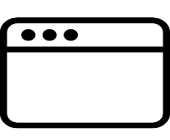

Monolithic challenge – New types of client applications
Search
Reviews
Cart
Checkout
Contact
Search
Catalog
Reviews
Cart
Customer
Shipping
Payment
Order
Contact
Search
Product
Inventory
Cart
Customer
Shipping
Payment
Order
Contact
DB

Slide 11

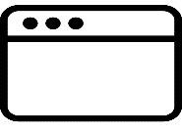




Monolithic challenge – New types of persistence/services
Search
Reviews
Cart
Checkout
Contact
Search
Catalog
Reviews
Cart
Customer
Shipping
Payment
Order
Contact
Search
Product
Reviews
Cart
Customer
Shipping
Payment
Order
Contact
DB

Slide 12





Monolithic challenge – Single codebase, deployment, versioning, and team size (continued)
Features
Test
Prod
Codebase
continuous
delivery
SCM

Slide 13
Monolithic challenge – Single codebase, deployment, versioning, and team size (Continued)
Features
Features
Features
Codebase
Test
Prod
continuous
delivery
SCM

Slide 14
Monolithic challenge – Using teams / language constructs
Features
Features
Flaw discovered during
user acceptance testing
ALL features held up!
Features
Codebase
Test
Prod
Codebase
Artifact
continuous
delivery
Codebase
SCM

Slide 15
Understanding the monolithic implementation
Single application executable
Easy to comprehend, but not to digest
Must be written in a single language
Modularity based on Program Language
Using the constructs available in that language (packages, classes, functions, namespaces, and frameworks)
Various storage/service technologies used
RDBMS, Messaging, email, and so on

Slide 16

Monolithic advantages
Easy to comprehend (but not digest)
Easy to test as a single unit (up to a size limit)
Easy to deploy as a single unit
Easy to manage (up to a size limit)
Easy to manage changes (up to a point)
Easy to scale (when care is taken)
Complexity managed by language constructs

Slide 17

Monolithic drawbacks
Language/Framework Lock:
Entire app written with single technology stack
Cannot experiment/take advantage of emerging technologies
Digestion:
Single developer cannot digest a large codebase
Single team cannot manage a single large application - Amazon's “2 Pizza” rule
Deployment as single unit:
Cannot independently deploy single change to single component
Changes are “held-hostage” by other changes

Slide 18
Agenda
Definitions
Monolithic architecture
Microservices architecture
Practical considerations

Slide 19
What are Microservices?
Microservices is an application architectural style composed of microservice components.
Architectural styles have evolved into:
Monolithic – One large application that does everything
Microservices – Several smaller applications that each does part of the whole
Service orientation has evolved into:
Service-Oriented Architecture (SOA) – Focused on technical integration issues, concentrating on technical APIs
Microservices – Focused on business capabilities, concentrating on business APIs

Slide 20

Key tenets of a Microservices Architecture
Large monoliths broken down into many small services - Each service runs in its own process. The applicable cloud rule is one service per container.
Services optimized for a single function – There is one and only one business function per service.
Communication through REST API and message brokers - Avoid tight coupling introduced by communication through a database.
Per-service CI/CD - Services evolve at different rates. You let the system evolve but set architectural principles to guide that evolution.
Per-service HA/clustering decisions - Not one size fits all. Not all services need to scale; others require auto-scaling up to very large numbers.

Slide 21
What defines the boundary of a Microservice?
A Microservice:
Serves one purpose …one logical business concept
Has a well-defined data boundary ... one primary data source
Has a tightly controlled interface ... one swagger description
Is built by a small unified team … one XL pizza can feed the whole team
Is built and deployed as a unit … one DevOps pipeline; one release schedule

Slide 22

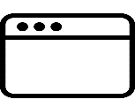



Shopping Cart Application using Microservices architecture
API Gateway
API Gateway
API Gateway
Reviews
Checkout
Search
Cart
Payment
Shipping
Catalog
Inventory
Contact
Customer
Order
DB

Slide 23
Componentization via Services
Not language constructs
Where services are small, independently deployable applications
Forces the design of clear interfaces
Changes scoped to their affected service
Reviews
Checkout
Search
Cart
Payment
Shipping
Catalog
Inventory
Contact
Customer
Order

Slide 24


Microservices composed using suite of small services
Services are small, independently deployable applications
Not a single codebase
Not (necessarily) a single language/framework
Reviews
Checkout
Search
Cart
Payment
Shipping
Catalog
Inventory
Contact
Customer
Order

Slide 25
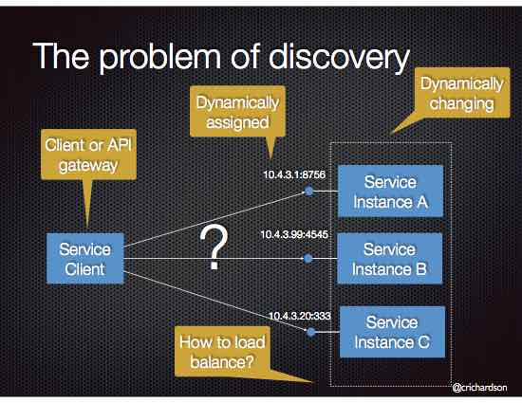
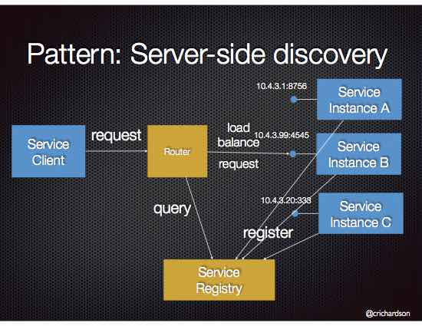
The problem of discovery
Services are small, independently deployable applications
Not a single codebase
Not (necessarily) a single language/framework

Slide 26
Microservices communicate based on lightweight protocols
HTTP, TCP, UDP, Messaging, and so on
Payloads: JSON, BSON, XML, Protocol Buffers, and so on
Forces the design of clear interfaces
Netflix's Cloud Native Architecture – Communicate through APIs
Not Common Database
Reviews
Checkout
HTTP
Search
Cart
AMQP
Payment
Shipping
Catalog
TCP
Inventory
HTTP
Contact
Customer
HTTP
AMQP
Order

Slide 27





Microservices are easily managed
Easy to comprehend, alter, test, version, deploy, manage, overhaul, and replace
By small, cross-functional teams (or even individuals)
Search
Reviews
Cart
Contact
Test
Prod
continuous
delivery

Slide 28
What kind of apps benefit from Microservices?
Systems of Record will benefit the most from a Microservices approach
Are you storing complex data about people, events, and things in your app?
Reasons: Size, logical divisions of a domain
Systems of Engagement may also benefit from a Microservices approach
Are you primarily allowing user access to existing data or allowing simple changes?
Can apply the “Backends for Frontends” pattern for channels
Systems of Insight may not benefit as much
Other architectural patterns like pipes and filters may be more appropriate

Slide 29
Advantages of Microservices
Easy to digest each service (difficult to comprehend whole system)
Very easy to test, deploy, manage, version, and scale single services
Change cycle decoupled
Easier to scale staff
No Language/Framework lock

Slide 30

Challenges of Microservices
Greater operational complexity because there are more moving parts to monitor and manage
Developers must have significant operational skills (DevOps)
Service interfaces and versions
Duplication of effort across service implementations
Extra complexity of creating a distributed system with these issues, among others:
Network latency
Fault tolerance
Serialization
Designing decoupled non transactional systems is difficult
Avoiding latency of large numbers of small service invocations
Locating service instances
Maintaining availability and consistency with partitioned data
End-to-end testing

Slide 31
Comparing Monolith and Microservices architecture
Category | Microservices Architecture | Monolithic Architecture
Architecture | Built as a suite of small services | Built as a single logical executable
Modularity | Based on business capabilities | Based on language features
Agility | Changes can be applied to each service independently | Changes to the system involve building and deploying a new version of the entire application
Scaling | Each service scaled independently when needed | Entire application scaled when only one part is the bottleneck
Implementation | Each service can be developed in a different programming language | Typically entirely developed in one programming language
Maintainability | Smaller code bases easier to manage | Large code base is intimidating to new developers
Deployment | Simple deployment as each service can be deployed individually, with minimal if not zero downtime | Complex deployments with maintenance windows and scheduled downtimes

Slide 32
Agenda
Definitions
Monolithic architecture
Microservices architecture
Practical considerations

Slide 33

How Teams Work
How Apps are Delivered
How Apps are Built
Notes:
How Teams Work
Where Things Run
How Things Move
Cloud Native – Environment
Containers – Simplicity

Slide 34
Microservices
Containers
Cloud Native
Notes:
How Teams Work
Where Things Run
How Things Move
Cloud Native – Environment
Containers – Simplicity

Slide 35
Cloud Native changes everything
Distributed computing
Today, with microservices architecture, apps are being built as a distributed collection of services, which pairs up perfectly with the distributed nature of the cloud. The advantages of this approach mean that, for individual microservices, you can now take advantage of automation in various ways to maximise efficiency and free time and money (e.g. auto-scaling, -provisioning and –redundancy)
Break down Team Silos
Traditional apps require many teams for each stage of an app’s development e.g. Dev, QA, database admins, release management, etc. With microservices, team structures can be realigned to reflect the change in architecture. Modern software delivery teams are small and cross-functional, organised by the services they support. This keeps teams agile, improves collaboration and quickens decision-making. It also eliminates a host of accountability issues, whereby teams can relinquish responsibility for a feature after it is moves on from their team, but before it is released.
Release at the Speed of Ideas (!)
With the right infrastructure, the right tools to manage it, and the right team structure the cumulative effect is that cloud-native releases become much more frequent. Every release affects a single service, or a couple of services at most. With limited scope, errors are easy to spot and fix. Rollback is easy with many tools capable of automatic rollbacks when a new version fails. Autonomous teams can ship updates to the services they own without dependencies. The largest web companies deploy thousands of times a day. This is the biggest advantage of a cloud-native architecture—that it takes you from idea to app in the quickest possible time.

Slide 36

Containers is the standard mechanism for Microservice Delivery
A standard way to package an application and all its dependencies so that it can be moved between environments and run without change.
Containers work by hiding the differences between applications inside the container so that everything outside the container can be standardized.
Notes:
Microservices are typically deployed as containers, which is a way of packaging an application. Containers also are portable, so can be moved from one cloud environment to another. The standard container we would use is Docker, and container orchestration is Kubernetes

Slide 37
APIs are not a new name for SOA Services
There are many similarities – but one very important difference:
The objective they are intended to achieve
“How can I increase the pace of innovation?”
“How can I increase the agility and effectiveness of delivery?”
APIs
SOA
Reuse → Speed to deliver
Sharing → Expediency
Encapsulate → Less to learn
Reuse → Effort to deliver
Sharing → Effectiveness
Encapsulate → Less to change

Slide 38
APIs vs. Services vs. Microservices
Microservice architecture vs. Service oriented architecture
Trying to achieve many of the same things (enable the creation of re-usable business functions as isolated components), but at a very different scale. SOA evolved to become focused on the enterprise scale (though some would say that wasn’t the original intent).
Microservices, is primarily at the application scale.
Microservice component vs. Service component
Both describe the actual implementation of a business function. They differ primarily in granularity, but also arguably in maintainability, agility etc.
Microservices vs. SOA
Microservices are components. SOA is an architecture. What you’re probably trying to compare is Microservices Architecture with SOA (see above).
Microservices vs. APIs
APIs are an interface. A mechanism for exposing business function. Microservices are the component architecture used to implement those business functions. It makes no sense to directly compare them.
Microservice vs. Service
“Service” means different things to different people. Needs to be qualified. Service Implementation? Service exposure? Service definition? The same could be said for microservice. Need to be specific.

Slide 39

Technology choices to build Cloud Native Applications
Use a PaaS Platform (Cloud Foundry) vs Use Docker Containers & Tools
Containers are the strategic choice for building cloud native applications
Both Cloud Foundry & Docker are converging to the same underlying container runtime
The container access/management approaches are different
Cloud Foundry is opinionated/restrictive in the level of control of the underlying container infrastructure
Some workloads will not be able to adapt to Cloud Foundry restrictions
On IBM Cloud, the choice between Cloud Foundry or Docker is not that drastic
Common user authentication & authorization model (based on Cloud Foundry UAA)
Common service broker
Common use of VCAP_SERVICES
Common DevOps tooling
Common metering
Emerging event-based programming models (OpenWhisk, AWS Lambda) are gaining popularity for specific workload types
Code
Code + Building Container Image
Cloud Foundry
Create Deployable Container Images
(Application Code + Buildpacks)
OpenWhisk
Docker
Container Management
(Cloud Foundry/Diego)
(Provisioning, Scheduling, Placement, Health)
Container Management
(IBM Containers, Swarm, Kubernetes)
(Provisioning, Scheduling, Placement, Health)
Containers
runC
Containers
Garden
Warden
Docker/runC
Linux cgroups & namespaces
Layered approach to isolated container root filesystem

Slide 40






















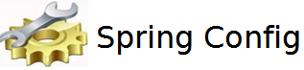






Modern Cloud Development Stack
Development Stack Example
Application Stack
Languages
Fabric
DevOps
Java
Routing/ Discovery
Eureka
Zuul
Amalgam8
Source Control
Log/ Analytics
Frameworks
GitHub
Strongloop, Express, Kitura, Microprfile, Spring
Urban Code Deploy
Monitoring
Build
Key Libraries
API Connect
Circuit Breaker
Messaging
Test
Tracing
Security
CI/CID
Testing
Config
Pipeline
Container Management (Kubernetes, Docker OSS, IBM Container Service)
Alternative Strategy: OpenWhisk and CF

Slide 41
Twelve factor applications
“a methodology for building software-as-a-service applications”
Created by the developers at Heroku
The Twelve Factors can be applied to applications
In any programming language
With any backing services (or cloud provider.. )
Ensuring resilient, fault-tolerant software
http://12factor.net/

Slide 42
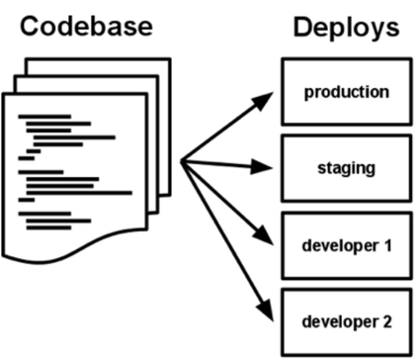
Twelve factors
Version controlled codebase
One-to-one: codebase and deployed service
Codebase is the same across deployments
Explicit, isolated dependencies
Configuration via environment
Replaceable backing services

Slide 43
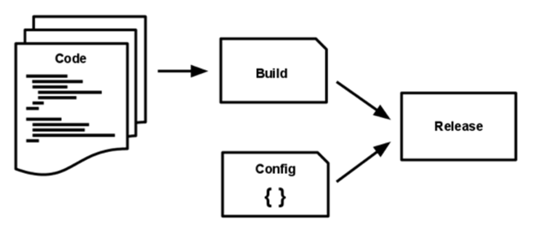
Twelve factors
Strictly separated stages
Build, release, run
App as one or more stateless processes
No sticky sessions → datastore w/ time-expiration
“Export services via port binding”
App is self contained, host/port provided by environment
Concurrency: horizontal scaling -- add more processes
Consider the type of work: request-driven HTTP vs. long-running background task

Slide 44
Twelve factors
Disposability: fast startup, graceful shutdown
e.g. use normal EE container lifecycle
Environment parity: dev → test → production
Logs as event streams
One-off admin scripts packed with the application
Same configuration / Same environment

Slide 45
Fallacies of distributed computing
The network is reliable
Latency is zero
Bandwidth is infinite
The network is secure
Topology doesn’t change
There is one administrator
Transport cost is zero
The network is homogenous
-- L Peter Deutsch, 1994
https://en.wikipedia.org/wiki/Fallacies_of_distributed_computing

Slide 46
How Do You Break a Monolith into Microservices?
Primary consideration: business functionality:
Noun-based (catalog, cart, customer)
Verb-based (search, checkout, shipping)
Single Responsibility Principle
"A class should have only one reason to change” (https://en.wikipedia.org/wiki/Single_responsibility_principle)
“Gather together the things that change for the same reasons. Separate those things that change for different reasons” (https://blog.cleancoder.com/uncle-bob/2014/05/08/SingleReponsibilityPrinciple.html)
(see also https://hackernoon.com/you-dont-understand-the-single-responsibility-principle-abfdd005b137)
Bounded Context
http://martinfowler.com/bliki/BoundedContext.html

Slide 47
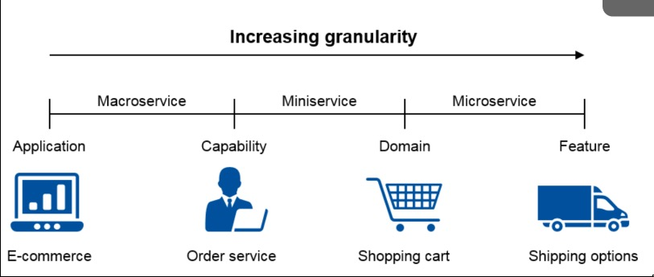
How Micro is Micro?
Code lines / bytes is not the compelling factor
Size of scope
Small enough for an individual developer to digest
Small enough to be built and managed by small team
Amazon's two pizza rule
Documentation small enough to read and understand
US Social Security Act of 1935 – 63 pages
US Affordable Care Act of 2010 – 906 pages
Dozens of secrets, not hundreds.
Predictable. Easy to experiment with

Slide 48

Are Monoliths Always Bad?
Consider etsy.com
As of February 2013:
1.49 billion page views.
4,215,169 items sold.
$94.7 million of goods sold.
22+ million members.
150 developers deploy single WAR 60 times a day.
Practices:
Continuous Integration.
Push button deployment.
Good monitoring. Dashboards
Developers deploy to prod on the first day.
VMs per developer, GitHub, Chef.
IRC to control releases.
No source control branches.

Slide 49
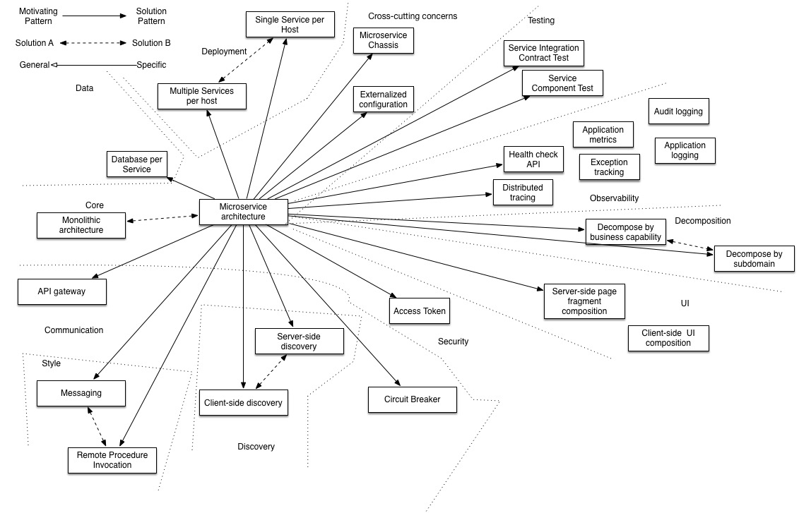
Microservices Patterns
https://microservices.io/patterns/microservices.html

Slide 50
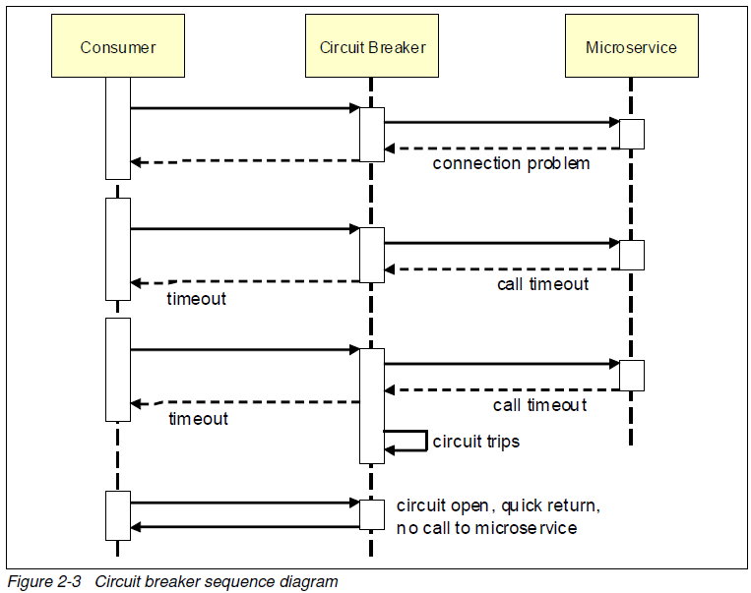
Microservices Patterns – Circuit Breaker
Use the Circuit Breaker pattern to protect remaining system in case of failures (Microservice is wrapped in a circuit breaker object).
After a certain number of requests to the downstream resource have failed, the circuit breaker is blown. All further requests fail fast while the circuit breaker is in its blown state. After a certain period of time, the consumer sends a few requests through to see if the downstream service has recovered, and if it gets enough healthy responses it resets the circuit breaker.
https://microservices.io/patterns/reliability/circuit-breaker.html

Slide 51
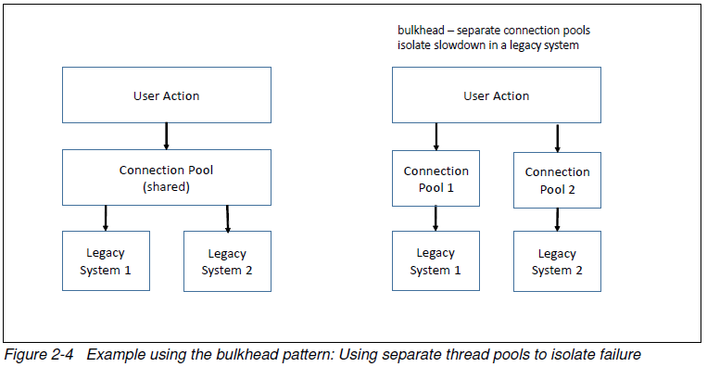
Microservices Patterns – Bulkhead
Use a Bulkhead pattern to isolate failure to small portions of the system.
In this example, If one of the legacy systems started to experience a slow down and caused the thread pool to get exhausted, access to the other legacy system would also be affected.
Having separate thread pools
would ensure that a slowdown in one legacy system would exhaust only its own thread pool,
and not affect access to the other.
https://docs.microsoft.com/en-us/azure/architecture/patterns/bulkhead

Slide 52
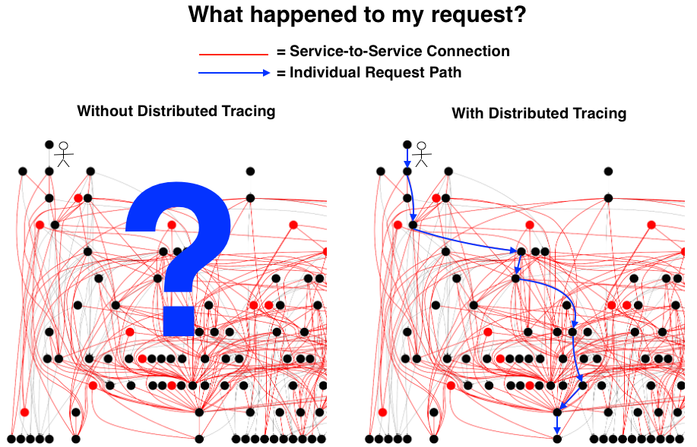
Microservices Patterns – Distributed Tracing
Distributed tracing tools:
OpenZipkin – zipkin.io
Jaeger – jaegertracing.io
Further tools:
https://developers.redhat.com/blog/2019/05/01/a-guide-to-the-open-source-distributed-tracing-landscape/
https://medium.com/nikeengineering/hit-the-ground-running-with-distributed-tracing-core-concepts-ff5ad47c7058

Slide 53
Discussion
An organization has decided to restructure an existing large monolith into microservices.
The plan calls for separate teams to develop the services:
Mobile developers / testers for the mobile app
Web developers / testers for the web pages
A team of Java / Spring developers to do the controller layer
A middleware team of Java / Spring developers building the service layer
Several small teams specialized on back-end persistence services; Oracle, Mongo, Redis, and Amazon S3
Do you have any thoughts on this plan?

Slide 54
Discussion
A small development team is considering switching to a microservices architecture.
Their application takes mobile surveys. A mobile app queries the back end for the survey and presents it to the user. When the user votes, the mobile app sends the vote to the back end, which records the vote on one DB table, and a tally of all votes for the survey on another table. The mobile app then queries the back end for the tally.
The team consists of two people, a mobile developer and a back-end / DB developer.
Do you have any advice?

Slide 55
Discussion
Which of the pros / cons of microservices are most applicable in your situation?
What are some potential services in your application?

